Slide 1
Vehicle Collisions in NYC:
A spatial analysis of injuries and risk aversion
By Aaron D'Souza, Priyanshi Singh, Nurvirta Monarizqa, Kaylyn Levine, Vishwajeet Shelar, and Patrick Mwangi

Slide 2
Approximately 4,000 New Yorkers are seriously injured in traffic collisions each year
On average, a New Yorker is injured or killed every two hours.
Source: http://www.nyc.gov/html/visionzero/pdf/nyc-vision-zero-action-plan.pdf

Slide 3

Approximately 4,000 New Yorkers are seriously injured in traffic collisions each year
On average, a New Yorker is injured or killed every two hours.
Increased enforcement
New street designs
Policy changes
Public outreach
Source: http://www.nyc.gov/html/visionzero/pdf/nyc-vision-zero-action-plan.pdf
Notes:
Current action plan from Mayor Bill de Blasio’s Vision Zero project

Slide 4
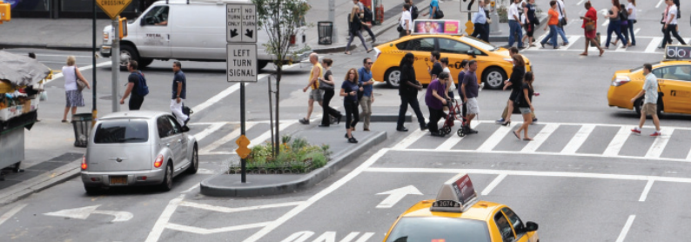
NYPD Motor Vehicle Collision Dataset:
January 1st, 2015 - January 1st, 2016
Only collisions with reported injuries
Cyclists, motorists, and pedestrians
Important attribute data:
Contributing factor
Vehicle type
Time and date
Latitude and longitude
Cause of highest number of collisions: driver inattention
Notes:
We wanted to use spatial analysis to see where the highest vehicle collision risk is, and provide recommendations for where vision zero should target their efforts
We analyzed this dataset in relation to other spatial features that may contribute to vehicle collisions: outside factors: population, street score and safety score ; inside factors: contributing factor

Slide 5
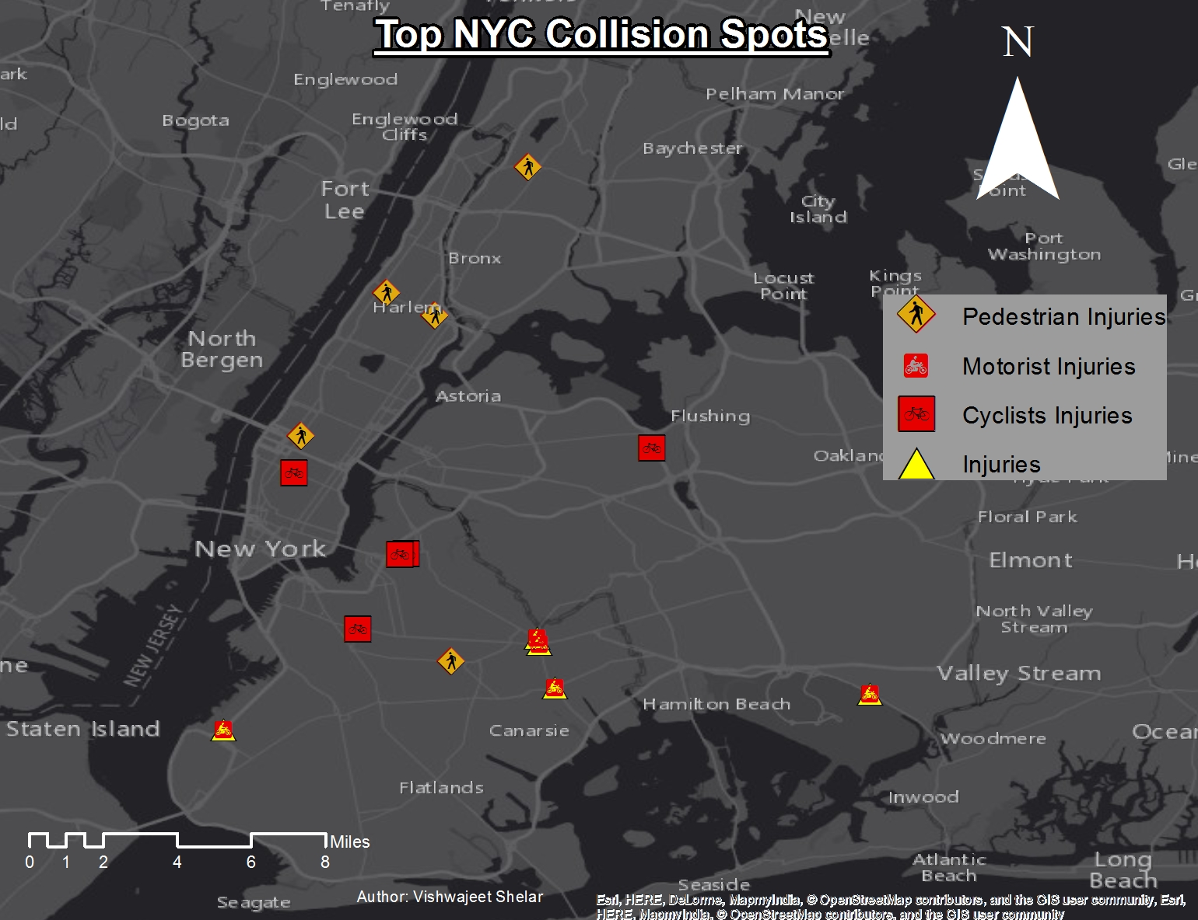

Slide 6
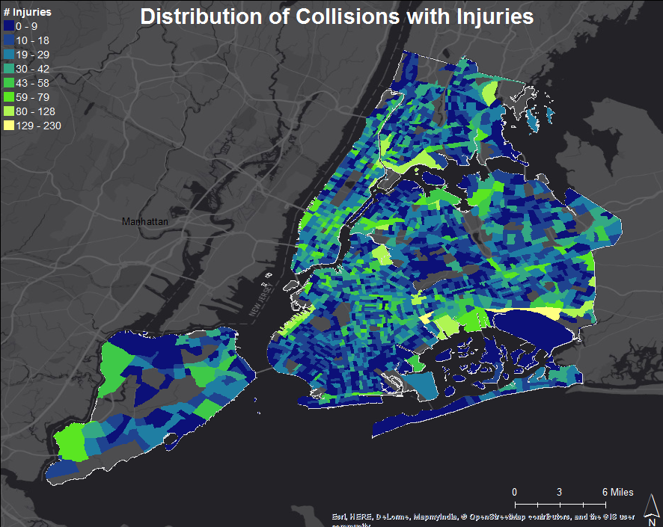
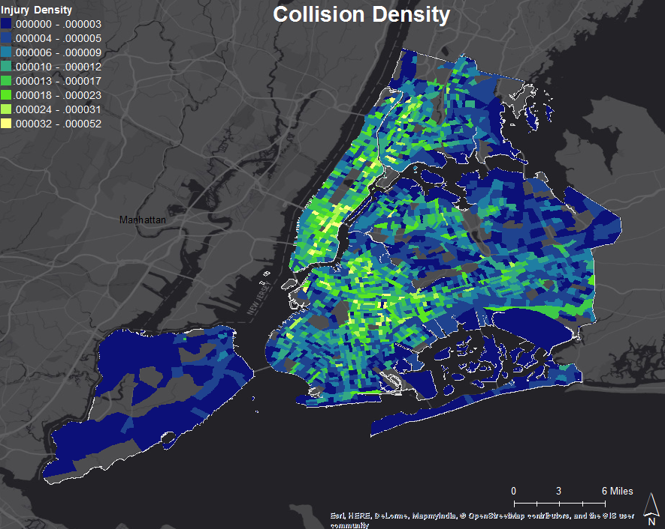
Exploration of Collision Data

Slide 7
External Factors Analyzed:
Population: Census and MTA Ridership
Under 18 population
Number of driving lanes
Street score
Safety score
Internal Factors Analyzed:
Top six contributing factors
Driver inattention
Failure to yield
Fatigued/drowsy
Pavement slippery
Traffic control disregard
Other
Notes:
We wanted to use spatial analysis to see where the highest vehicle collision risk is, and provide recommendations for where vision zero should target their efforts
We analyzed this dataset in relation to other spatial features that may contribute to vehicle collisions: outside factors: population, street score and safety score ; inside factors: contributing factor

Slide 8
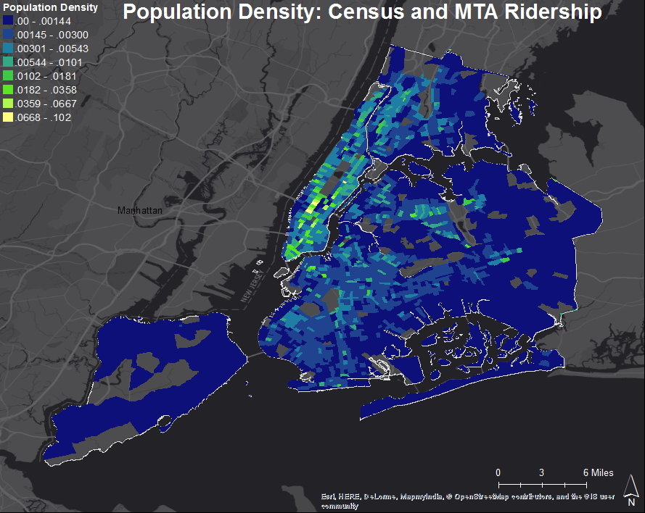
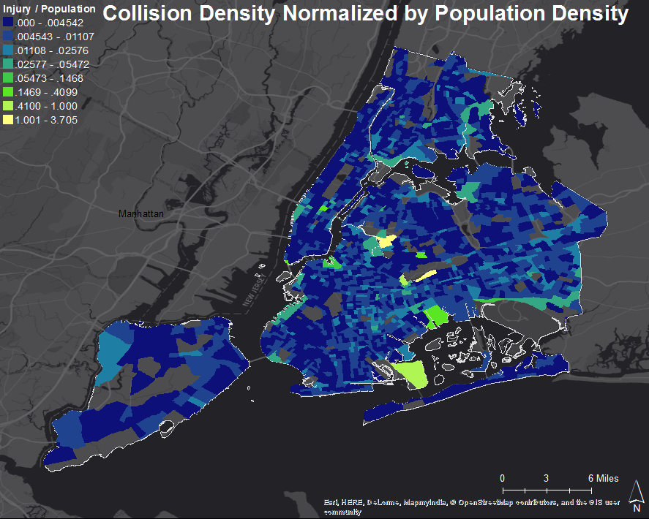
External Factor: Population

Slide 9
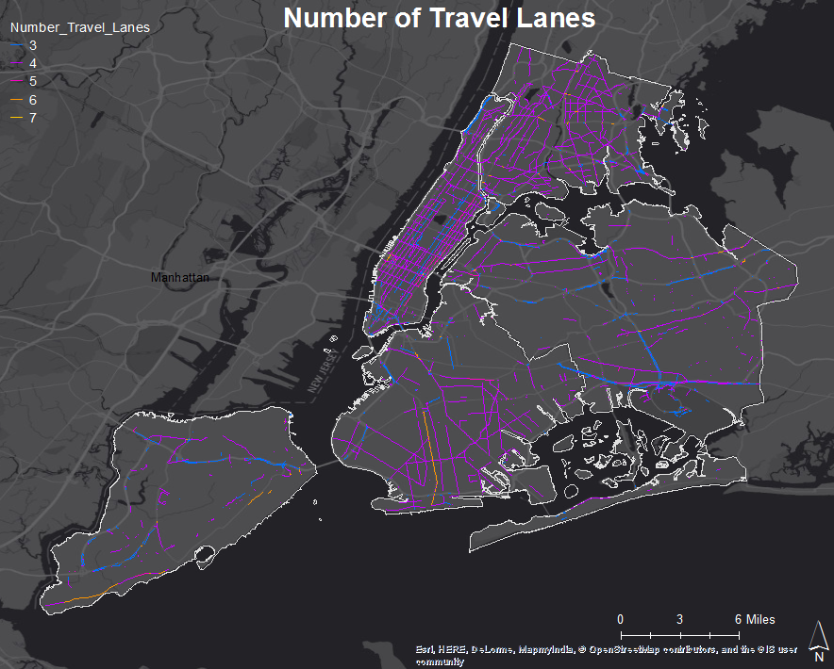
External Factor: Number of Travel Lanes

Slide 10
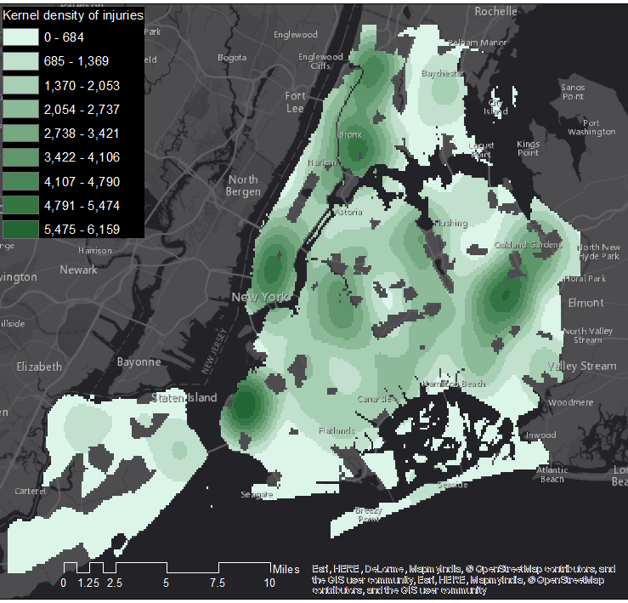
External Factor: Street Score

Slide 11
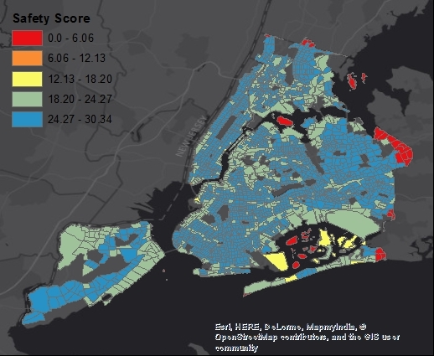
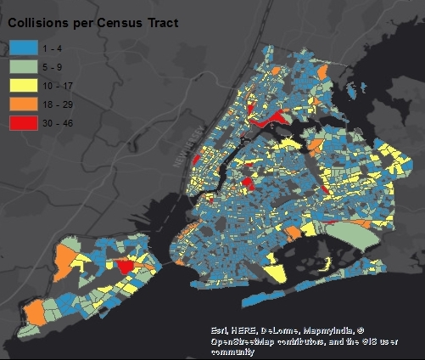
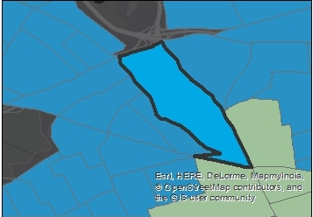
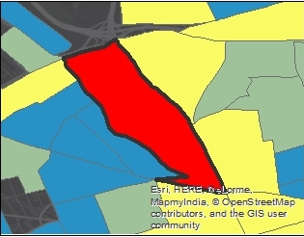
External Factor: Safety Score comparison with Collisions per Census Tract

Slide 12
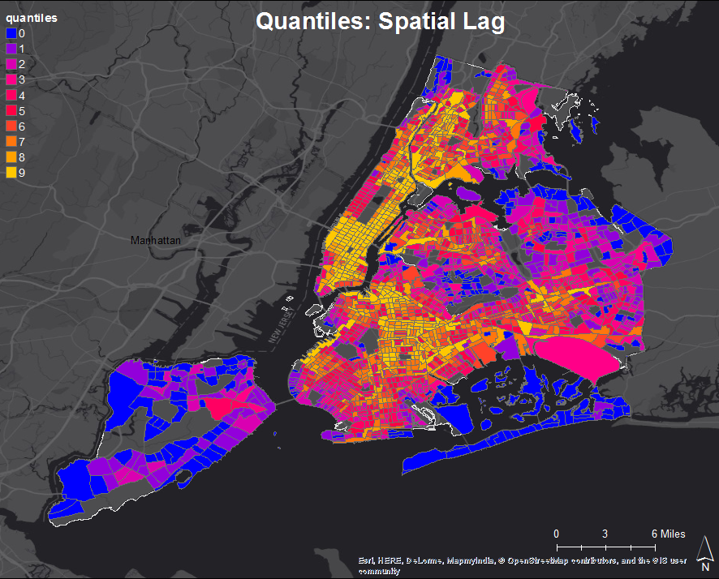
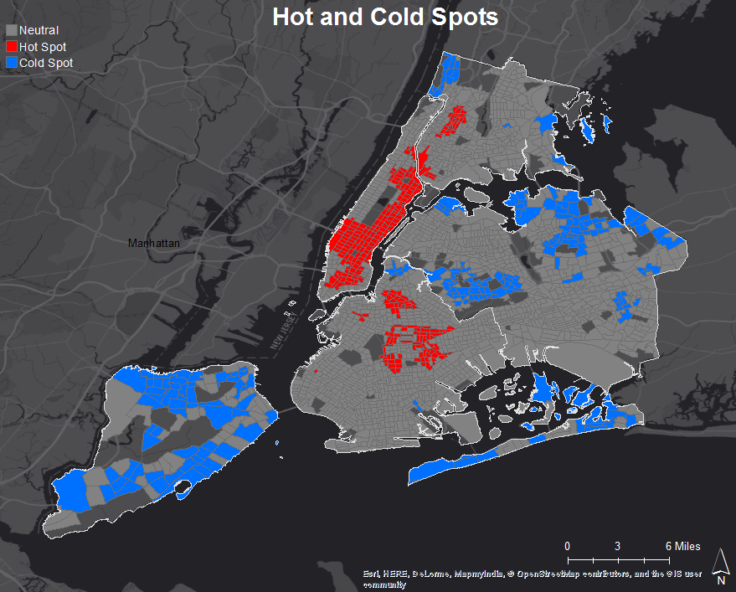
LISA: External Factors
Notes:
Regression: coefficient for average number of lanes is high in midtown Manhattan (largest hot spot) and Flatbush Brooklyn
Jaywalking: NYPD wants to increase enforcement through vision zero initiative
Street conditions in lower manhattan: below average

Slide 13
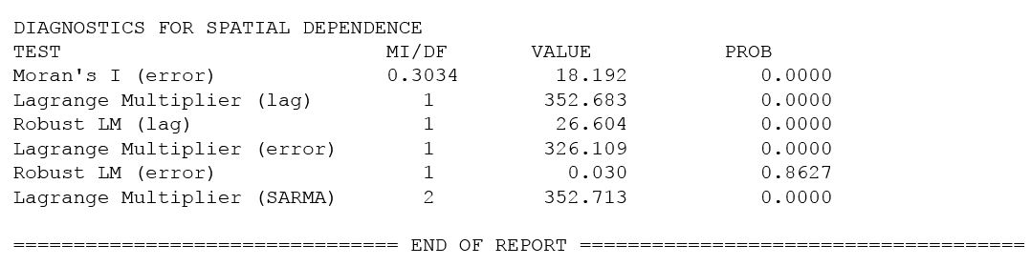
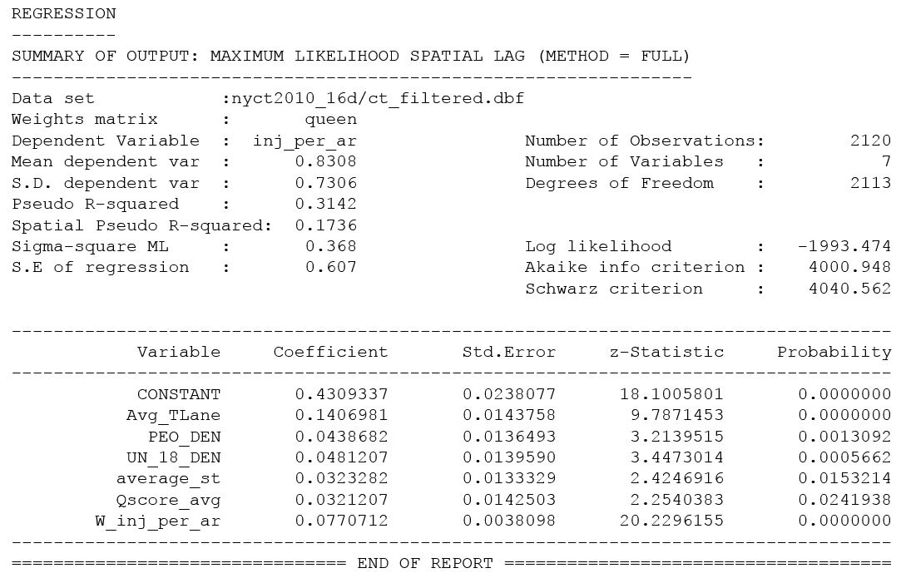
Spatial Regression: Internal Factors
Moran’s I: 0.3034
There is a spatial correlation here.
Highest coefficient: number of driving lane
Second highest: under 18 population
Notes:
Analysis of outside factors

Slide 14
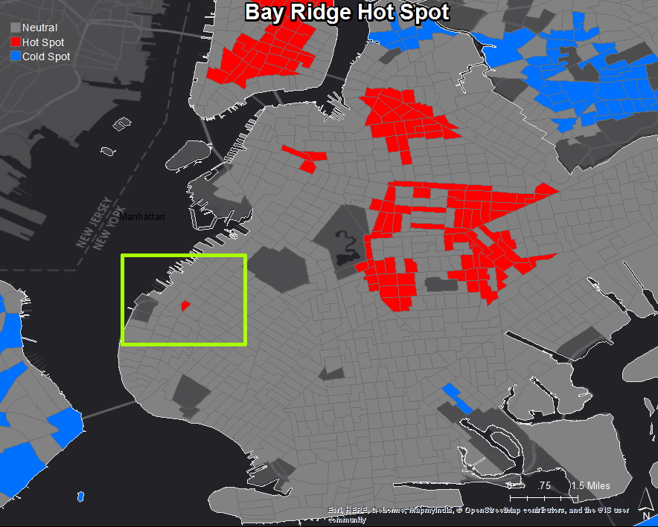
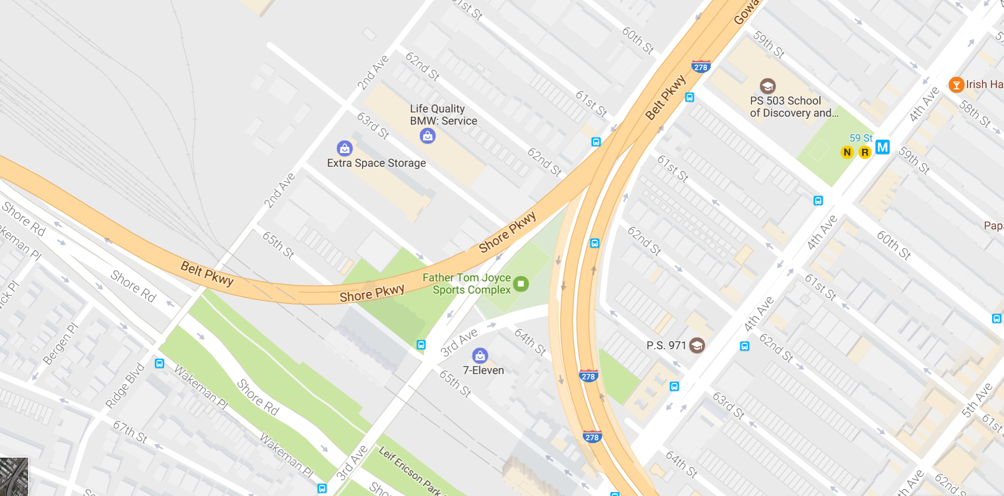
Notes:
Why is this census tract considered a hot spot?
Schools, car dealerships, two major roads intersect (highway), abundance of parks

Slide 15
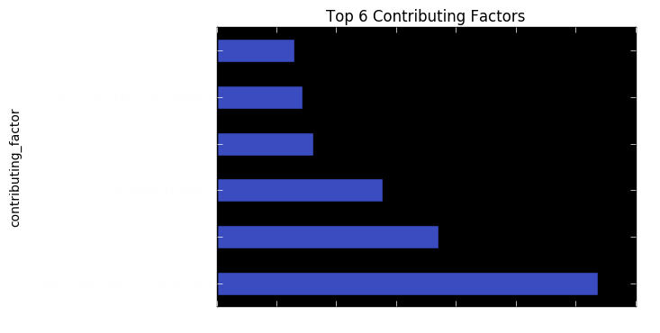
Internal Factors:
Contributing Factor Breakdown Before Spatial Analysis
Number of Injuries

Slide 16
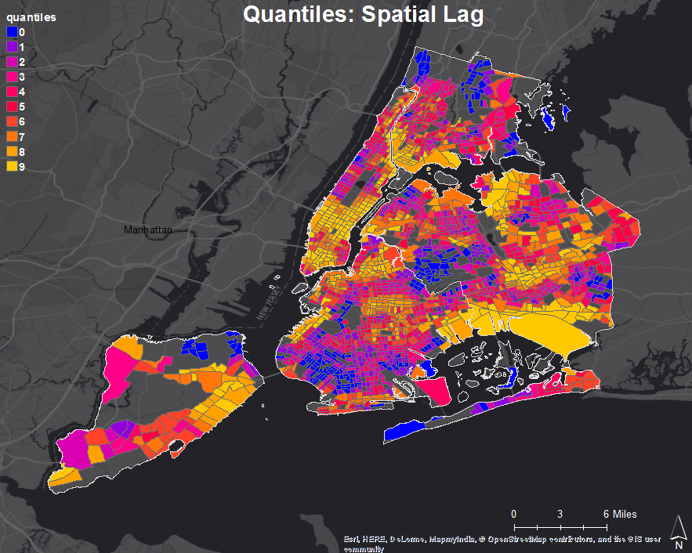
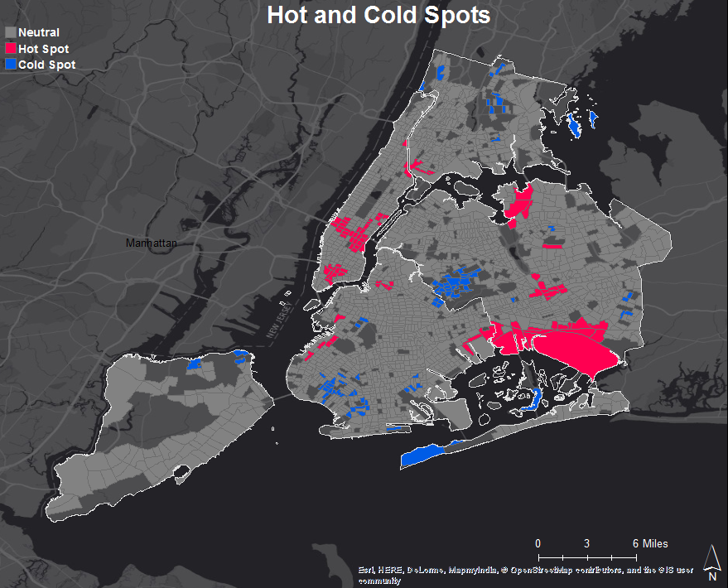
LISA: Internal Factors
Notes:
Traffic Control Disregard impacted the risk for vehicle collisions (hot spots) the most according to our analysis

Slide 17
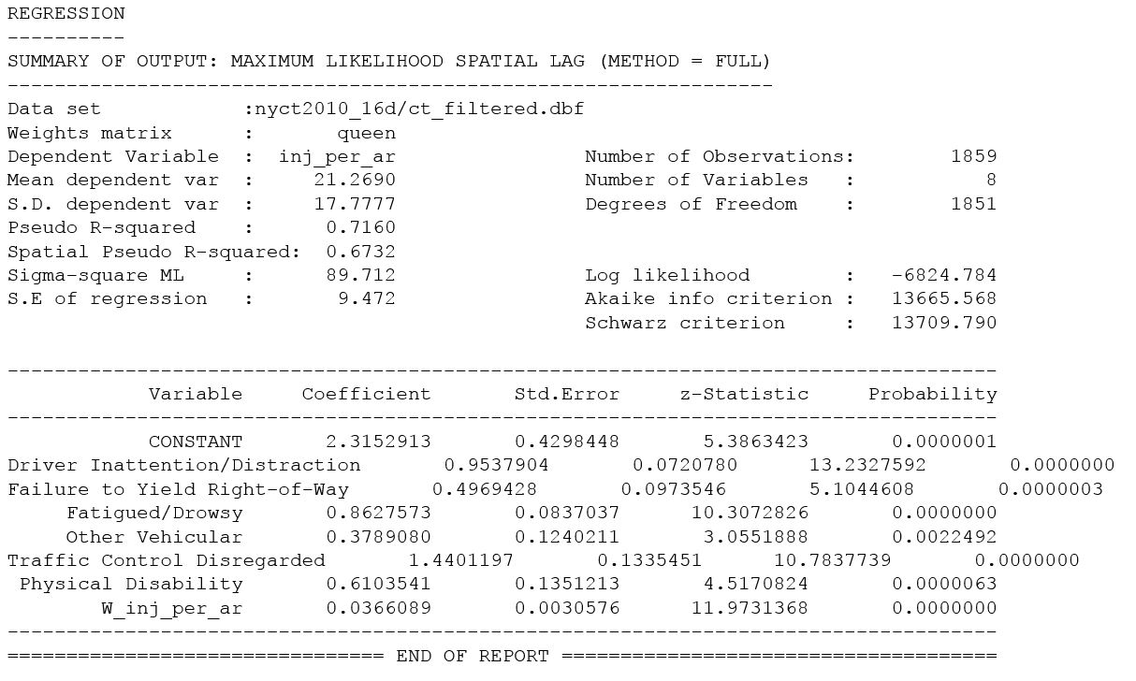
Spatial Regression: Internal Factors
Highest coefficient: Traffic control disregard → this factor is more impactful
Notes:
When you normalize injuries by the number of collisions or by the area of the census tract, Traffic Control Disregard becomes most impactful
Traffic control disregard: ignoring signals and signs, improper turns, failing to stop

Slide 18
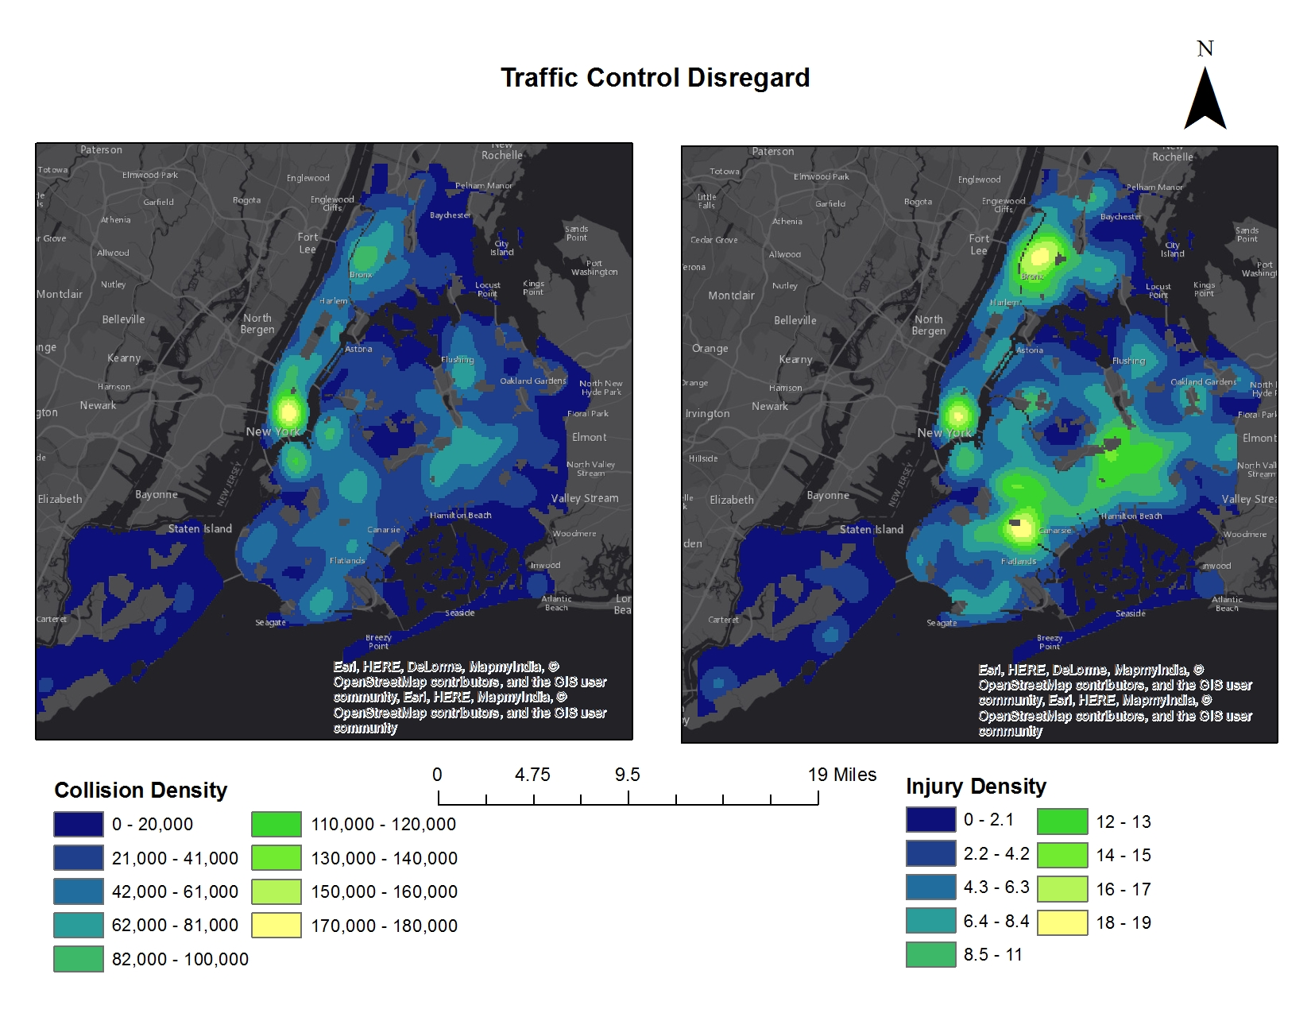
Notes:
Injuries normalised by number of collisions are more in Brooklyn, bronx

Slide 19
External Factor Conclusions:
Number of traffic lanes significantly impacted collision risk
Internal Factor Conclusions:
Most significant contributing factor to collision risk: traffic control disregard

Slide 20

Future Policy Changes:
External Factor Solutions:
Increase barriers between lanes and pedestrians
Jaywalking enforcement
Automated detection of pedestrians: video, urban sensors
Internal Factor Solutions:
Increased traffic fines
Increased signage
Intersection modifications
Remove parking adjacent to corners
Increase pedestrian visibility
Further reduction in speed limits
Notes:
By increasing policy and enforcement practices, traffic injuries and fatalities will decrease (graph from London?)
http://www.nyc.gov/html/visionzero/pdf/nyc-vision-zero-action-plan.pdf

